Slide 1
Revolutionizing Banking: The Bank Management System
A digital solution for seamless account management, secure transactions, and enhanced customer service.

Slide 2
OVERVIEW
Beyond the Teller
The Bank Management System is a comprehensive digital solution designed to automate and streamline core banking operations. By leveraging SQL-based operations and stored procedures, it ensures unparalleled accuracy, robust security, and operational efficiency, empowering banks to make faster, more informed decisions and deliver superior customer service.

Slide 3
OVERVIEW
ABSTRACT
DATA SET UPS
Introduction
BUSINESS ANALYSIS
WHATS MYSQL
Conclusion
SCHEMA & ERD
Reference

Slide 4
INTRODUCTION
Our System: A Foundation of Efficiency
Our Bank Management System is meticulously engineered to manage every facet of banking operations. From individual customer profiles to complex loan tracking, and from daily transactions to employee records, the system provides a structured and secure database environment. It automates critical tasks like repayment calculations, deposit/withdrawal tracking, and financial summary generation. Built with stored procedures, constraints, and triggers, it guarantees data integrity, reliability, and unparalleled efficiency for everyday banking.

Slide 5
TECHNOLOGY SPOTLIGHT
What is MySQL?
MySQL is a powerful, open-source relational database management system that utilizes SQL (Structured Query Language) to manage and organize data. It enables the creation of dynamic tables, execution of complex queries, and automation of routine tasks, facilitating highly efficient data handling. In the banking sector, MySQL is widely adopted for its speed, accuracy, and robust security features, making it ideal for managing sensitive financial information.

Slide 6
SYSTEM ARCHITECTURE
Schema & ERD Explained
MySQL is a powerful, open-source relational database management system that utilizes SQL (Structured Query Language) to manage and organize data. It enables the creation of dynamic tables, execution of complex queries, and automation of routine tasks, facilitating highly efficient data handling. In the banking sector, MySQL is widely adopted for its speed, accuracy, and robust security features, making it ideal for managing sensitive financial information.
Customers are central, linked to accounts, loans, and additional services. Accounts manage financial transactions via Transactions and can have multiple cards associated. Loans can have multiple Loan payments linked to them, representing the payment history. Employees manage customer interactions and transactions within specific Branches. Customer Services track services availed by customers, linking to specific Services offered by the bank or institution.

Slide 7
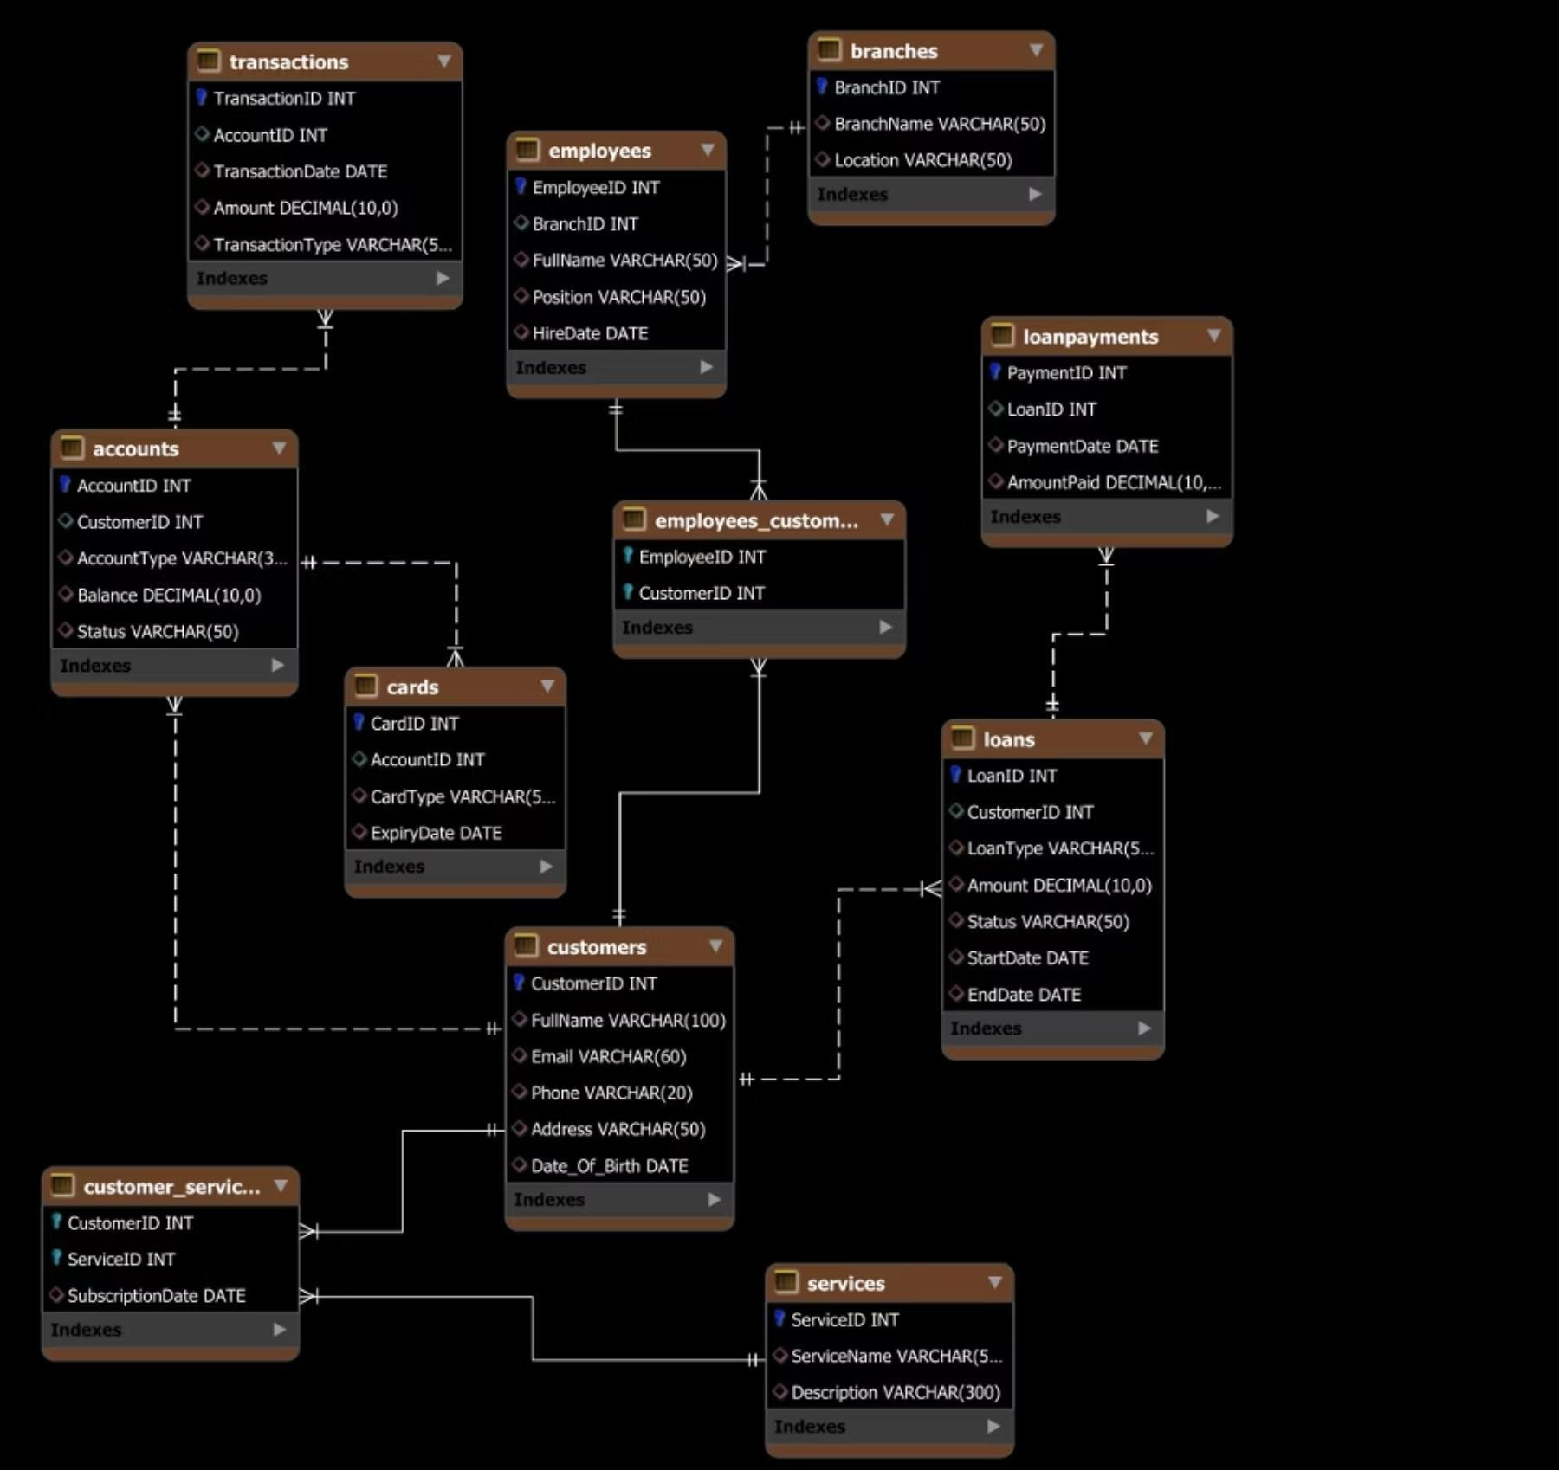
SCHEMA EXPLAINATION
Customers are central, linked to Accounts, Loans, and additional services.
Accounts manage financial transactions via Transactions and can have multiple Cards associated.
Loans can have multiple LoanPayments linked to them, representing the payment history.
Employees manage customer interactions and transactions within specific Branches.
Customer_Services track services availed by customers, linking to specific Services offered by the bank or institution.

Slide 8
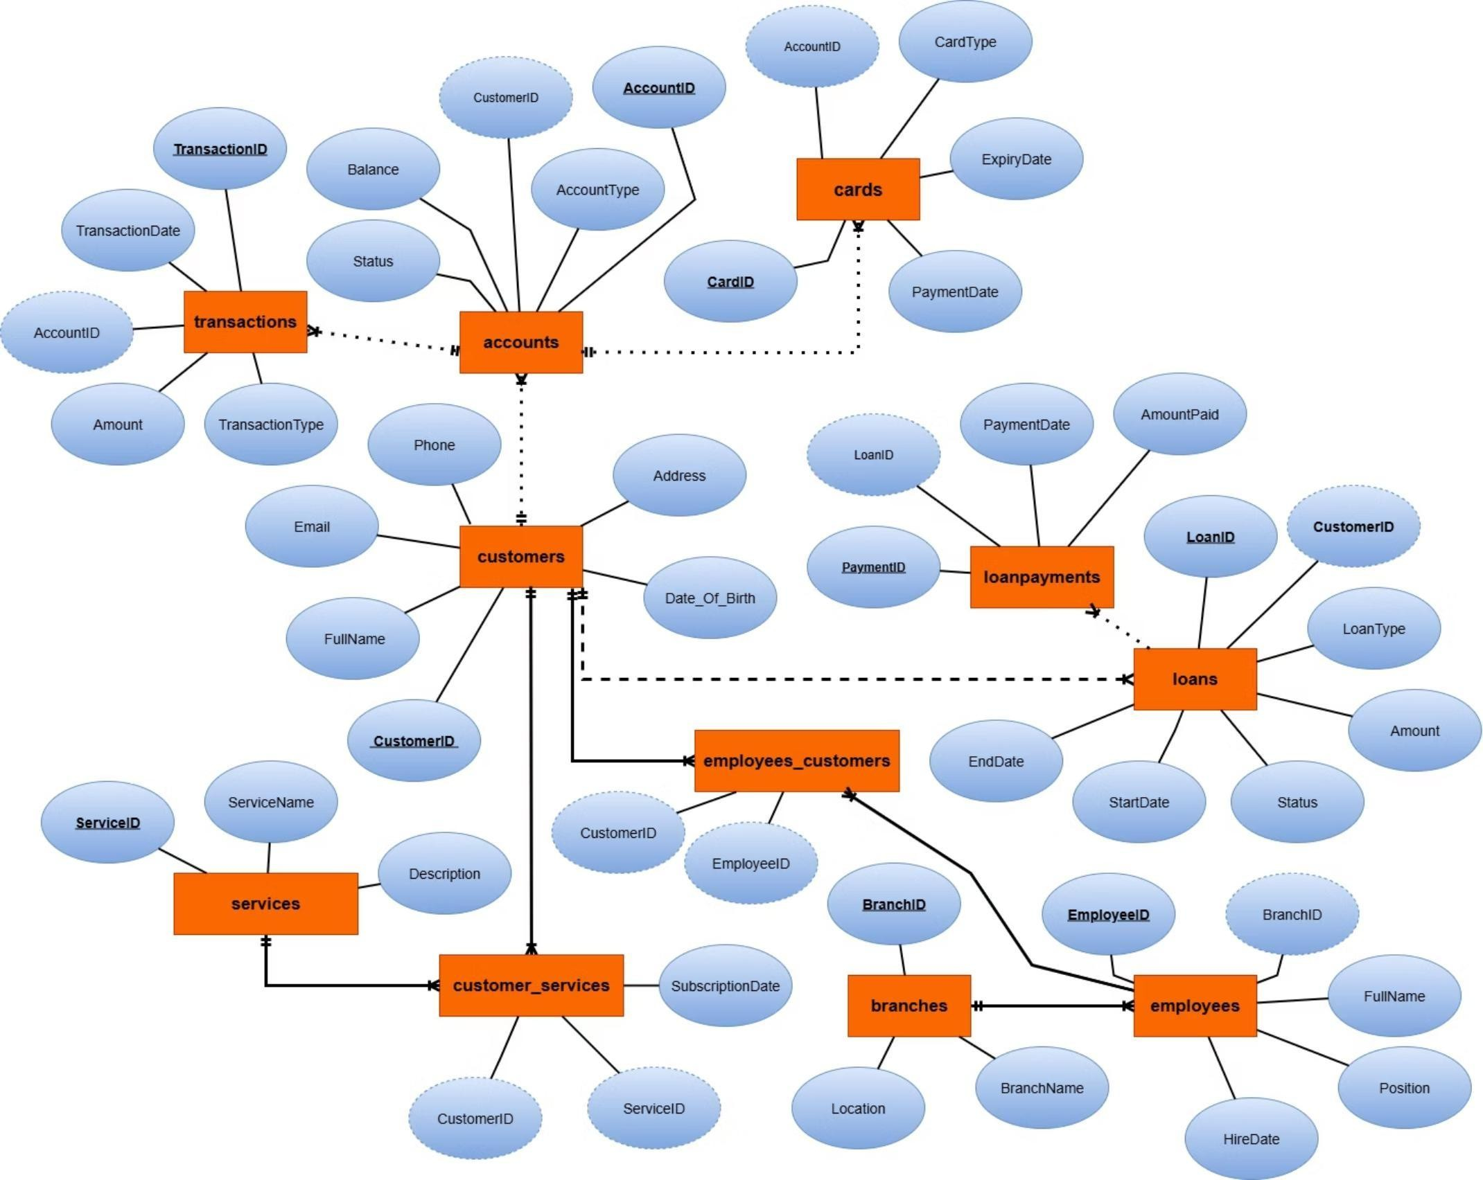
ERD
The schema represents a banking system with entities including transactions, accounts, customers, employees, loans, cards,branches, and services.
Relationships exist between entities, such as accounts linked to customers, transactions tied to accounts, and loans associatedwith customers.
Important attributes include IDs, names, dates, amounts, and statuses, facilitating efficient data management and retrieval.

Slide 9
DATA MANAGEMENT
CRUD Operations: Create
CREATE TABLE Accounts ( AccountID INT PRIMARY KEY,
CustomerID INT, AccountType VARCHAR(30),
Balance NUMERIC, Status VARCHAR(50),
FOREIGN KEY (CustomerID) REFERENCES Customers(CustomerID));

Slide 10
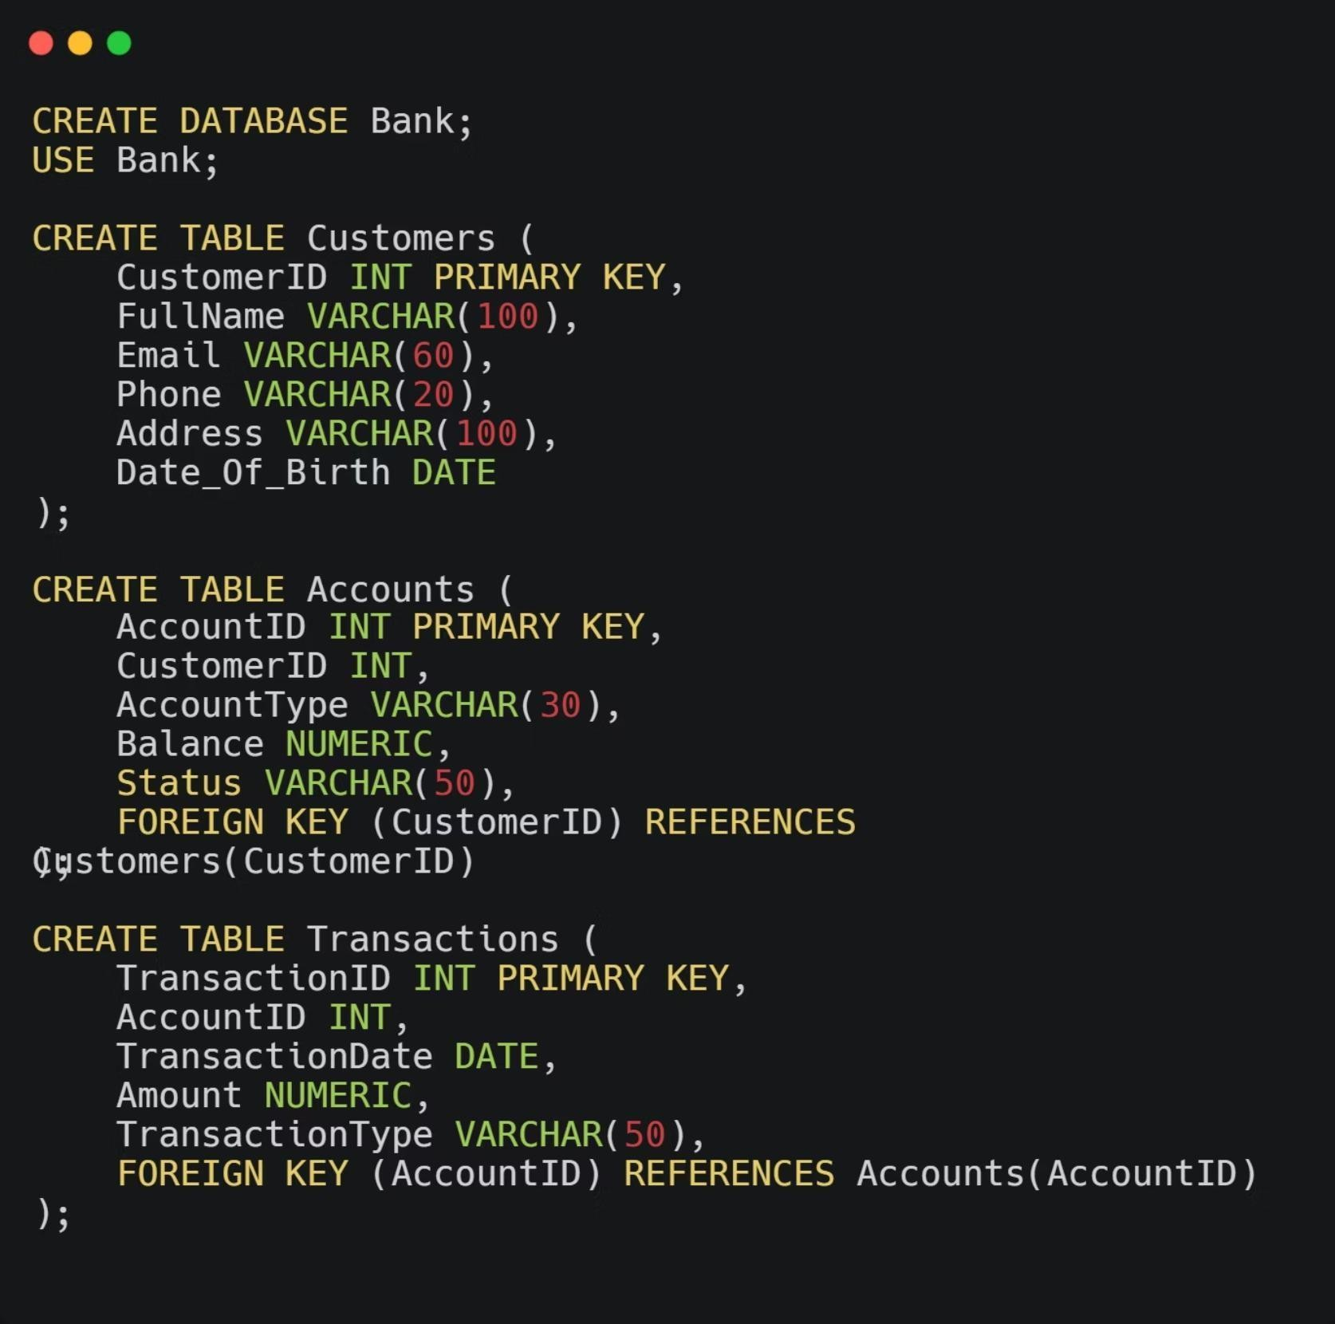
The CREATE operation is fundamental, allowing users to add new records or data entries into the database. This is essential for expanding and updating the system with new information. For instance, when a new client joins the bank, a new customer record is inserted into the customer table, capturing all their essential details.

Slide 11
DATA MANAGEMENT
CRUD Operations: Insert
INSERT INTO services (
ServiceID, ServiceName, Description) VALUES
(1, 'Online Banking', 'Access to accounts and transactions through the internet.’), (2, 'Mobile Banking', 'Banking services via mobile applications.’),
(3, 'Credit Card', 'Credit card issuance and management services.’), (4, 'Loan Services', 'Loan application and repayment services.’),
(5, 'Investment Services', 'Services for investments and portfolio management.’);
INSERT INTO Customer_Services (CustomerID, ServiceID, SubscriptionDate) VALUES (1, 4, '2023-05-22’),
(2, 10, '2023-02-09’),
(3, 1, '2024-09-06’),
(4, 3, '2024-12-11’),
(5, 9, '2022-08-11');

Slide 12

Data Insertion from Excel to MySQL using Python
We adopted this approach due to the large volume of available data, which made manual insertion into the database impractical. When we attempted to use both the script and the MySQL Workbench wizard, the data was rejected because it was in a different format. We tried to reformat the data without any loss, but this proved to be impossible. Consequently, we came up with a solution that not only allowed us to accomplish the task but also served as an excellent practical application of what we had learned in Python. It was therefore an ideal opportunity, and we did not waste any time: we inserted some of the records manually using the SQL INSERT statement, while the rest were added programmatically using Python.

Slide 13
DATA MANAGEMENT
CRUD Operations: Update
UPDATE Services
SET ServiceName = CASE ServiceID WHEN 1 THEN 'Loan Services' WHEN 2 THEN 'Online Banking' WHEN 3 THEN 'Saving Accounts' WHEN 4 THEN 'Fixed Deposit’
END,
Description = CASE ServiceID
used to modify existing records in a table. It allows you to change the values of one or more columns for one or more rows that meet a specified condition
 | WHEN | 1 | THEN | “Provides personal, home, and business loans.”
 | WHEN | 2 | THEN | “Secure internet-based banking services.”
 | WHEN | 3 | THEN | “Accounts for saving money with interest.”
 | WHEN | 4 | THEN | “Fixed-term deposits with higher interest rates.”
END
WHERE ServiceID BETWEEN 1 AND;

Slide 14
BUSINESS ANALYSIS
Business analysis is a systematic approach to identifying business needs and finding technical solutions to business problems. It involves understanding the organization's goals, processes, and challenges, and then using that understanding to recommend improvements or solutions that can enhance efficiency, effectiveness, and overall performance.

Slide 15
WHY BUSINESS ANALYSIS ?
Business analysis is a systematic approach to identifying business needs and finding technical solutions to business problems. It involves understanding the organization's goals, processes, and challenges, and then using that understanding to recommend improvements or solutions that can enhance efficiency, effectiveness, and overall performance.

Slide 16
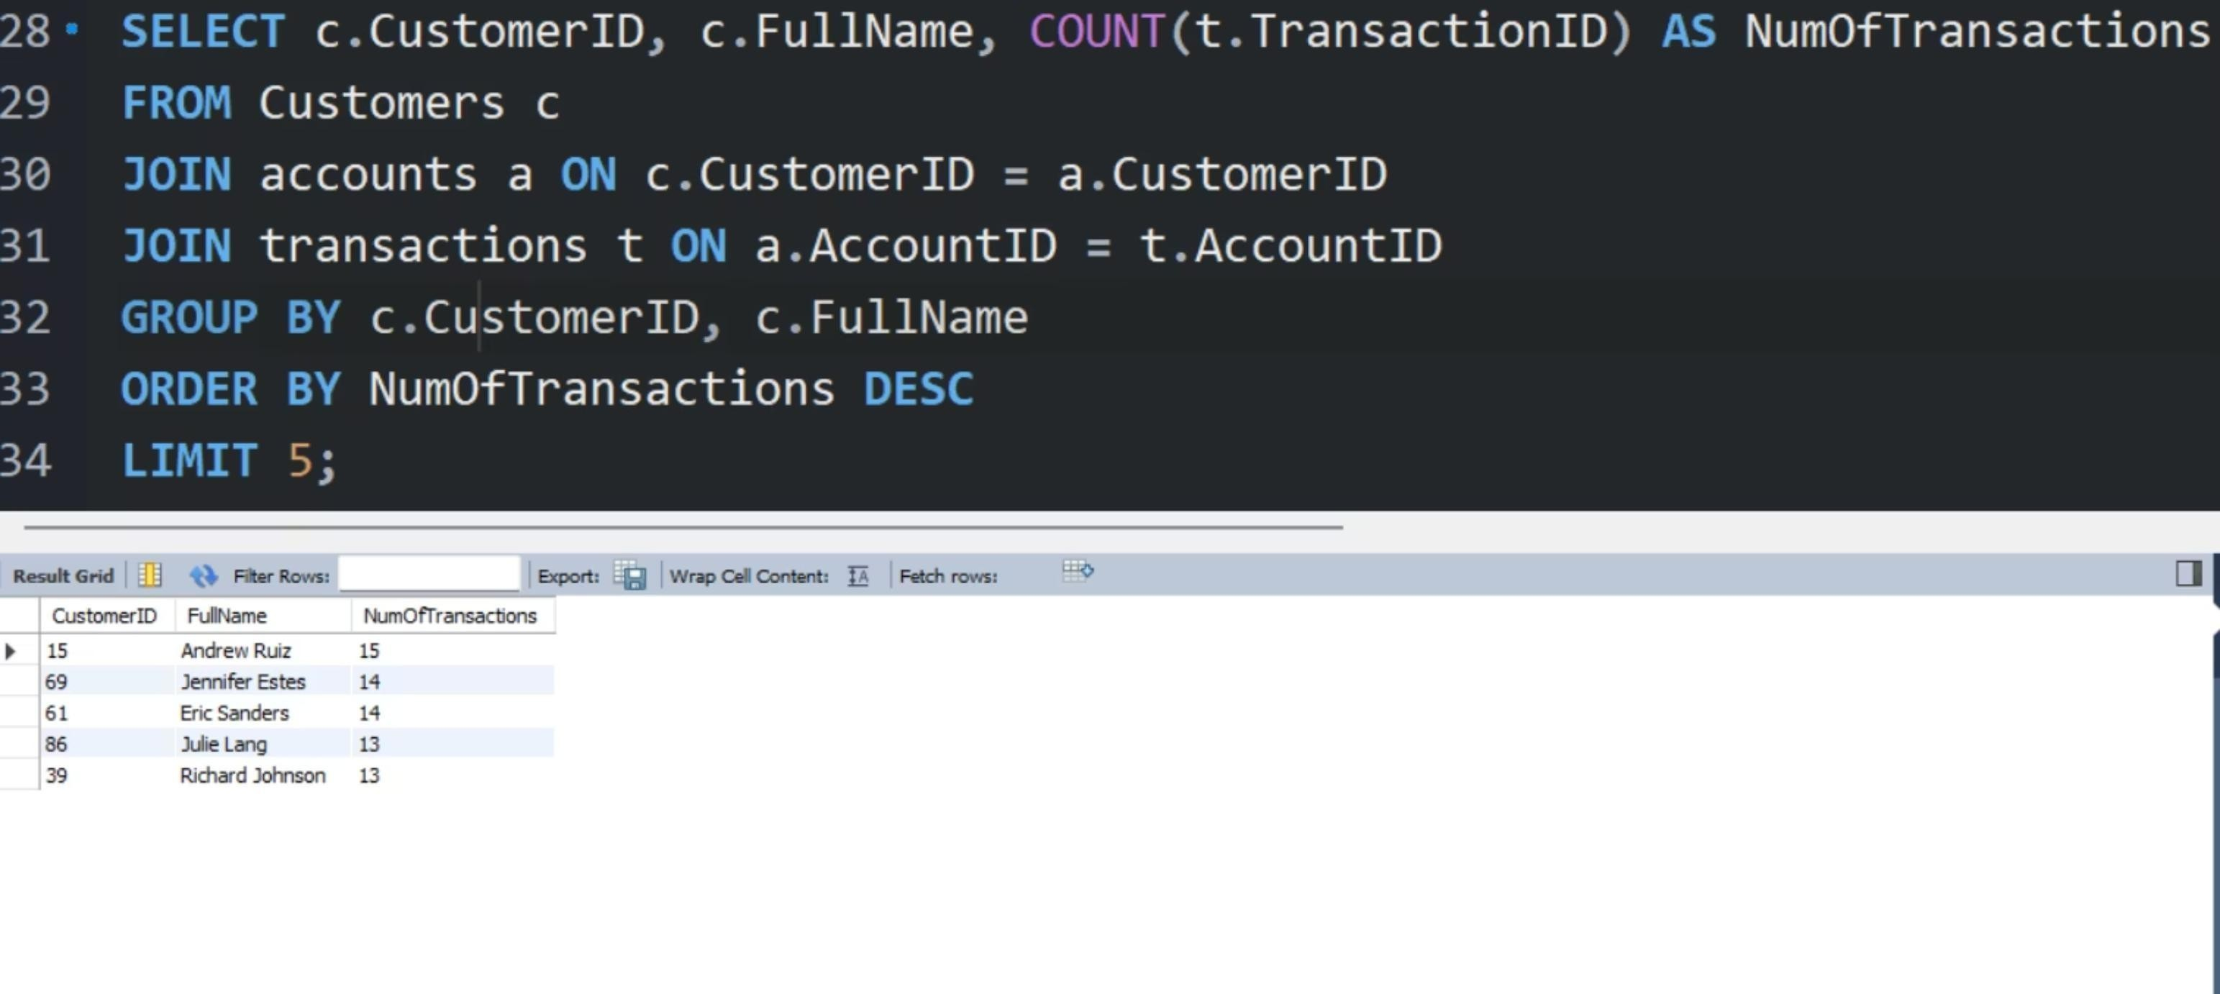
Insight 1 ) Retrieves the top 5 customers with the highest number of transactions in the bank, ordered from most to least

Slide 17
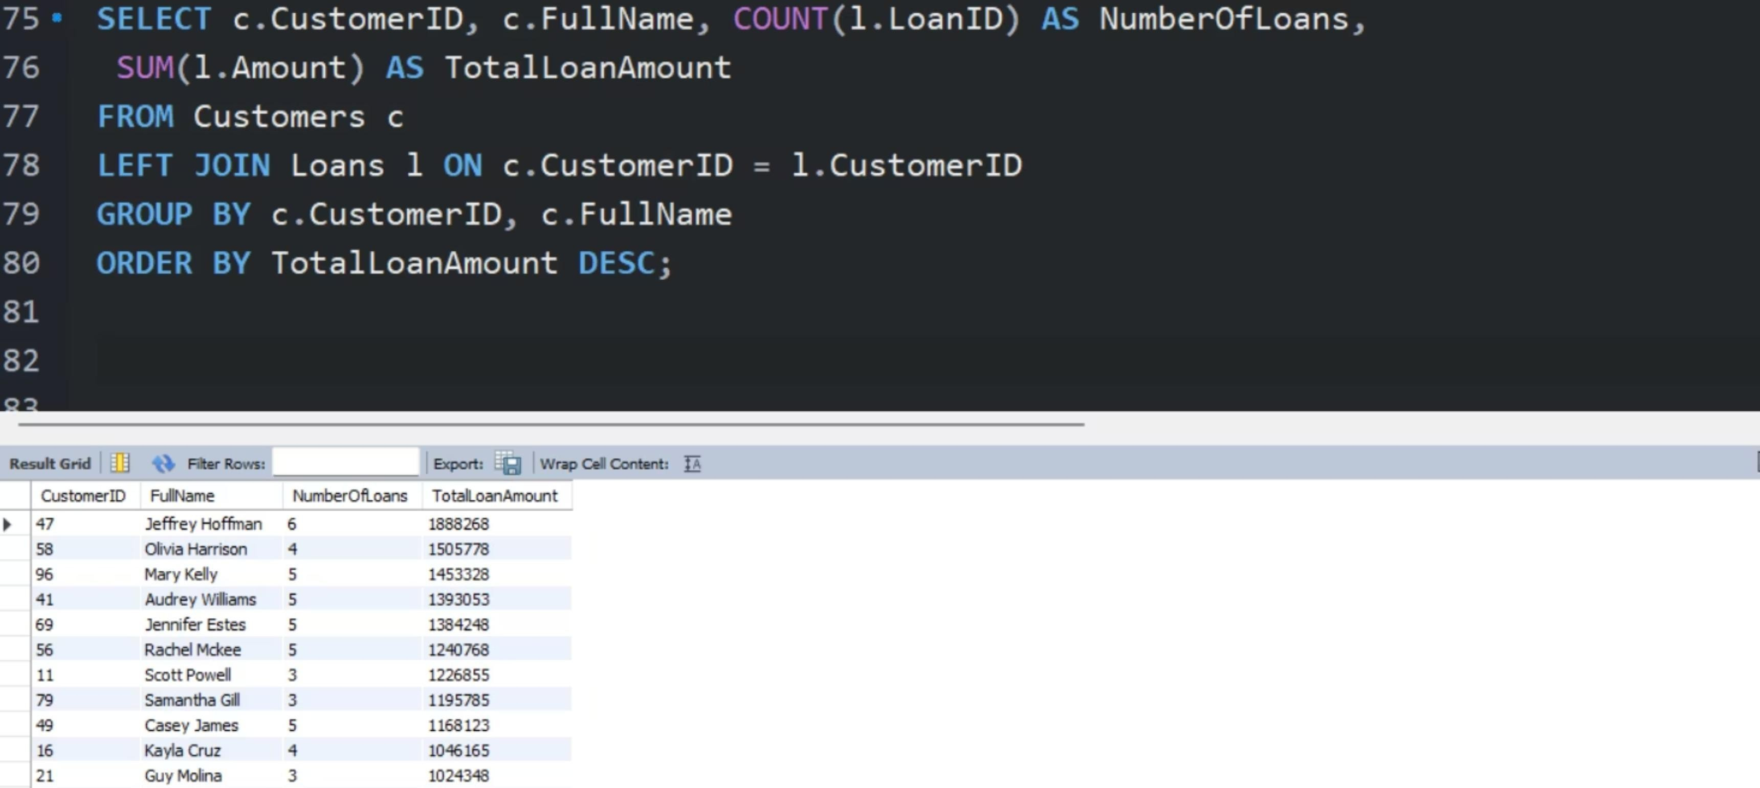
Insight 2 ) Rank customers by the total amount of loans they have taken, from highest to lowest.

Slide 18
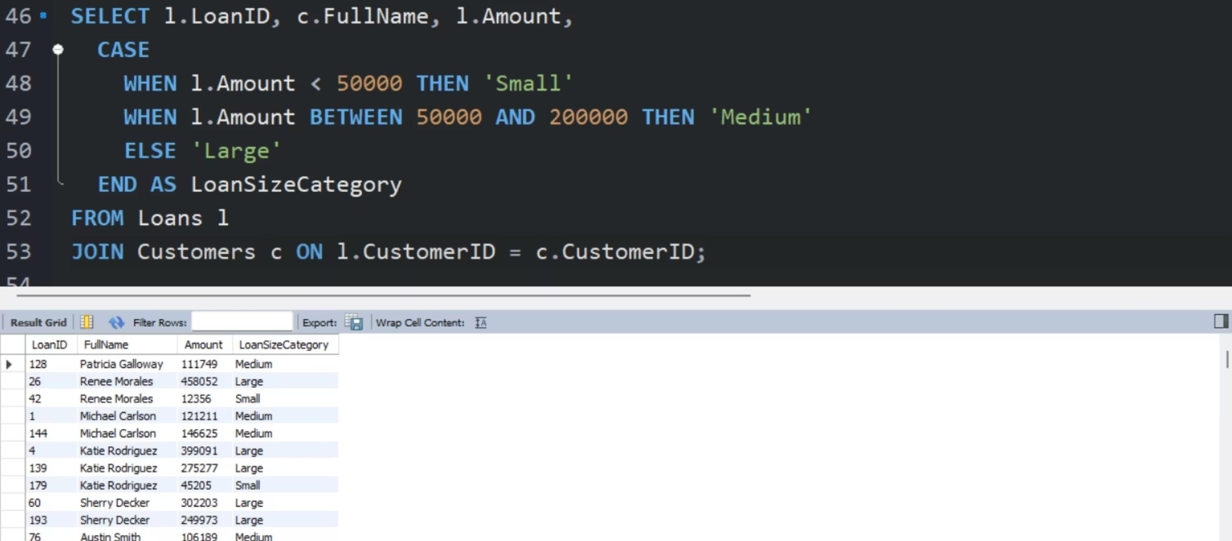
Insight 3 ) Calculate loan status based on amount: small, medium and large.

Slide 19
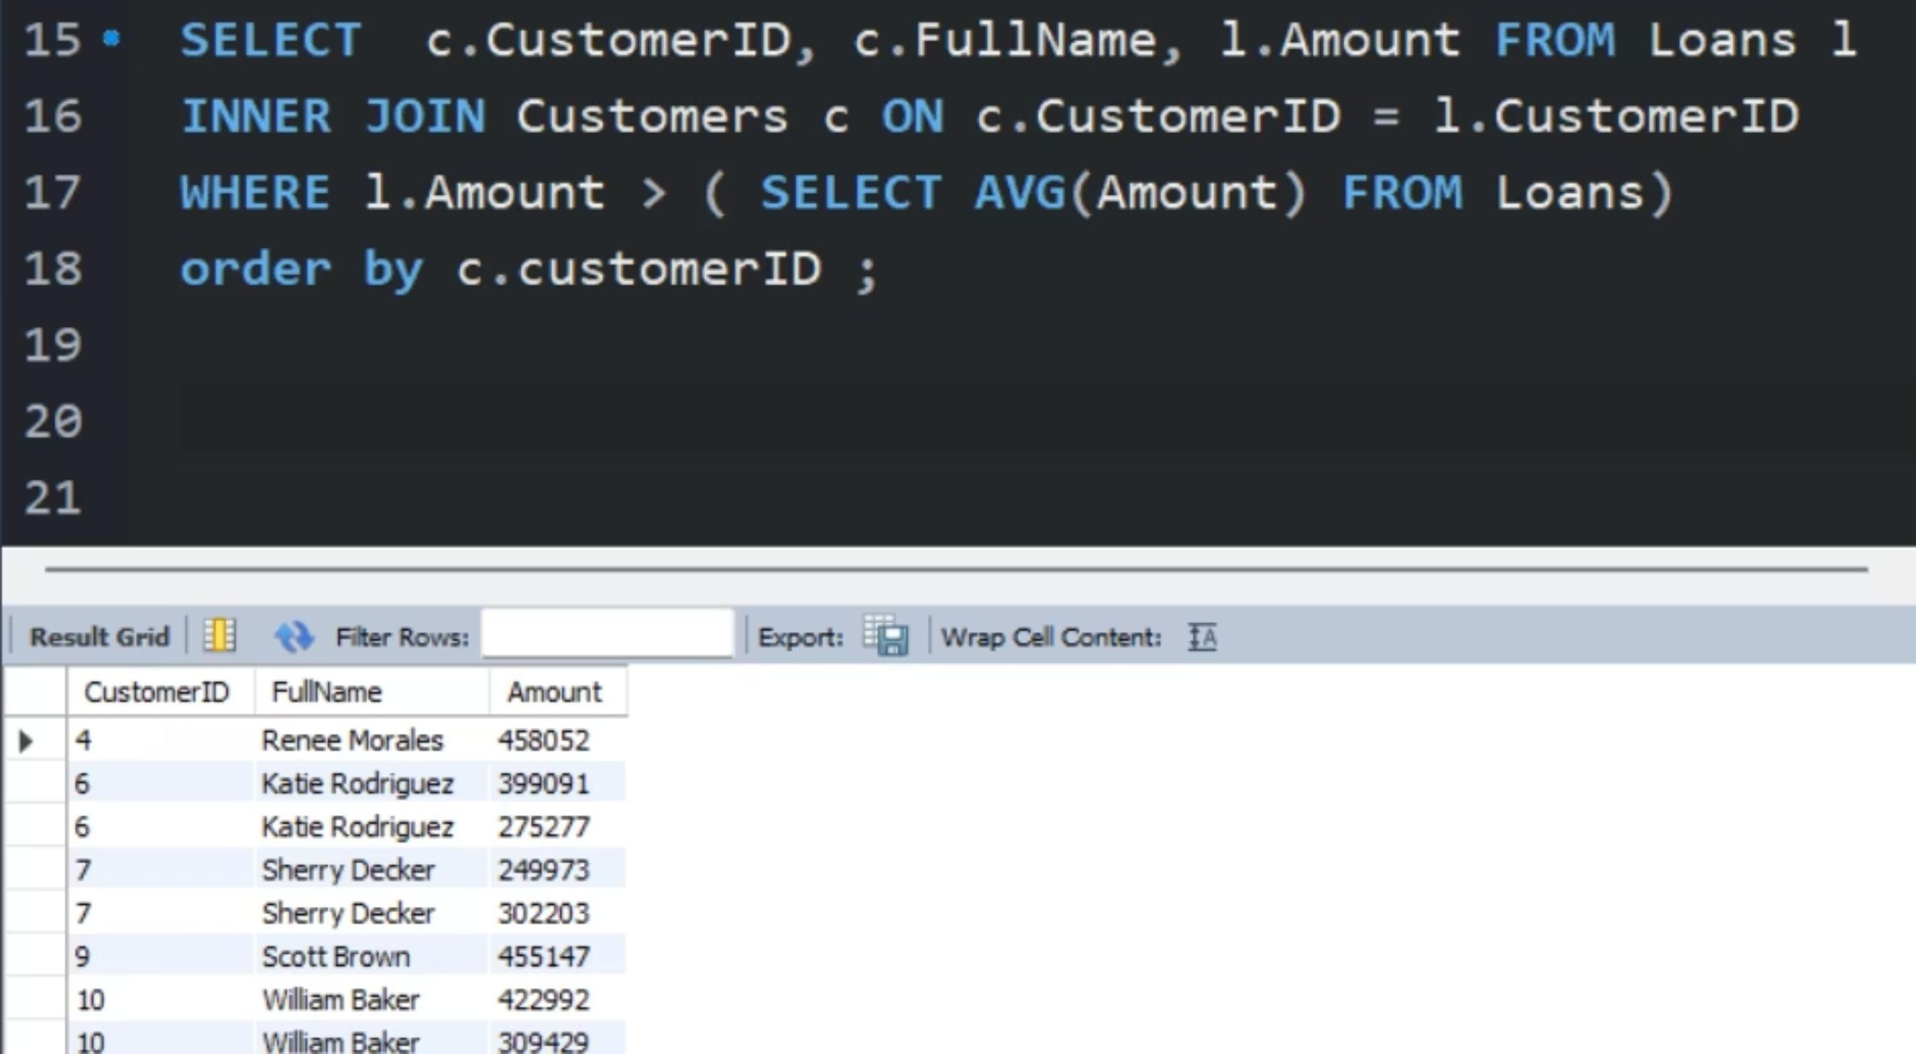
Insight 4 ) Retrieve clients who have taken out a loan with an amount greater than the average loan amount.

Slide 20
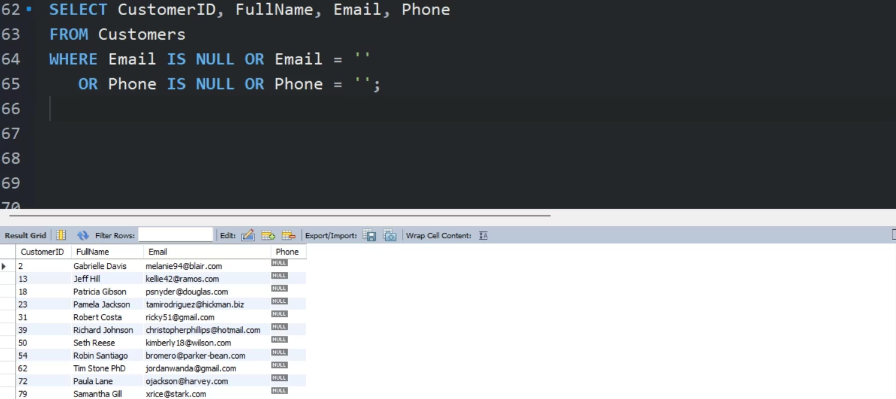
Insight 5 ) Find customers who are missing an email address or phone number. This is important for improving customer communication.

Slide 21
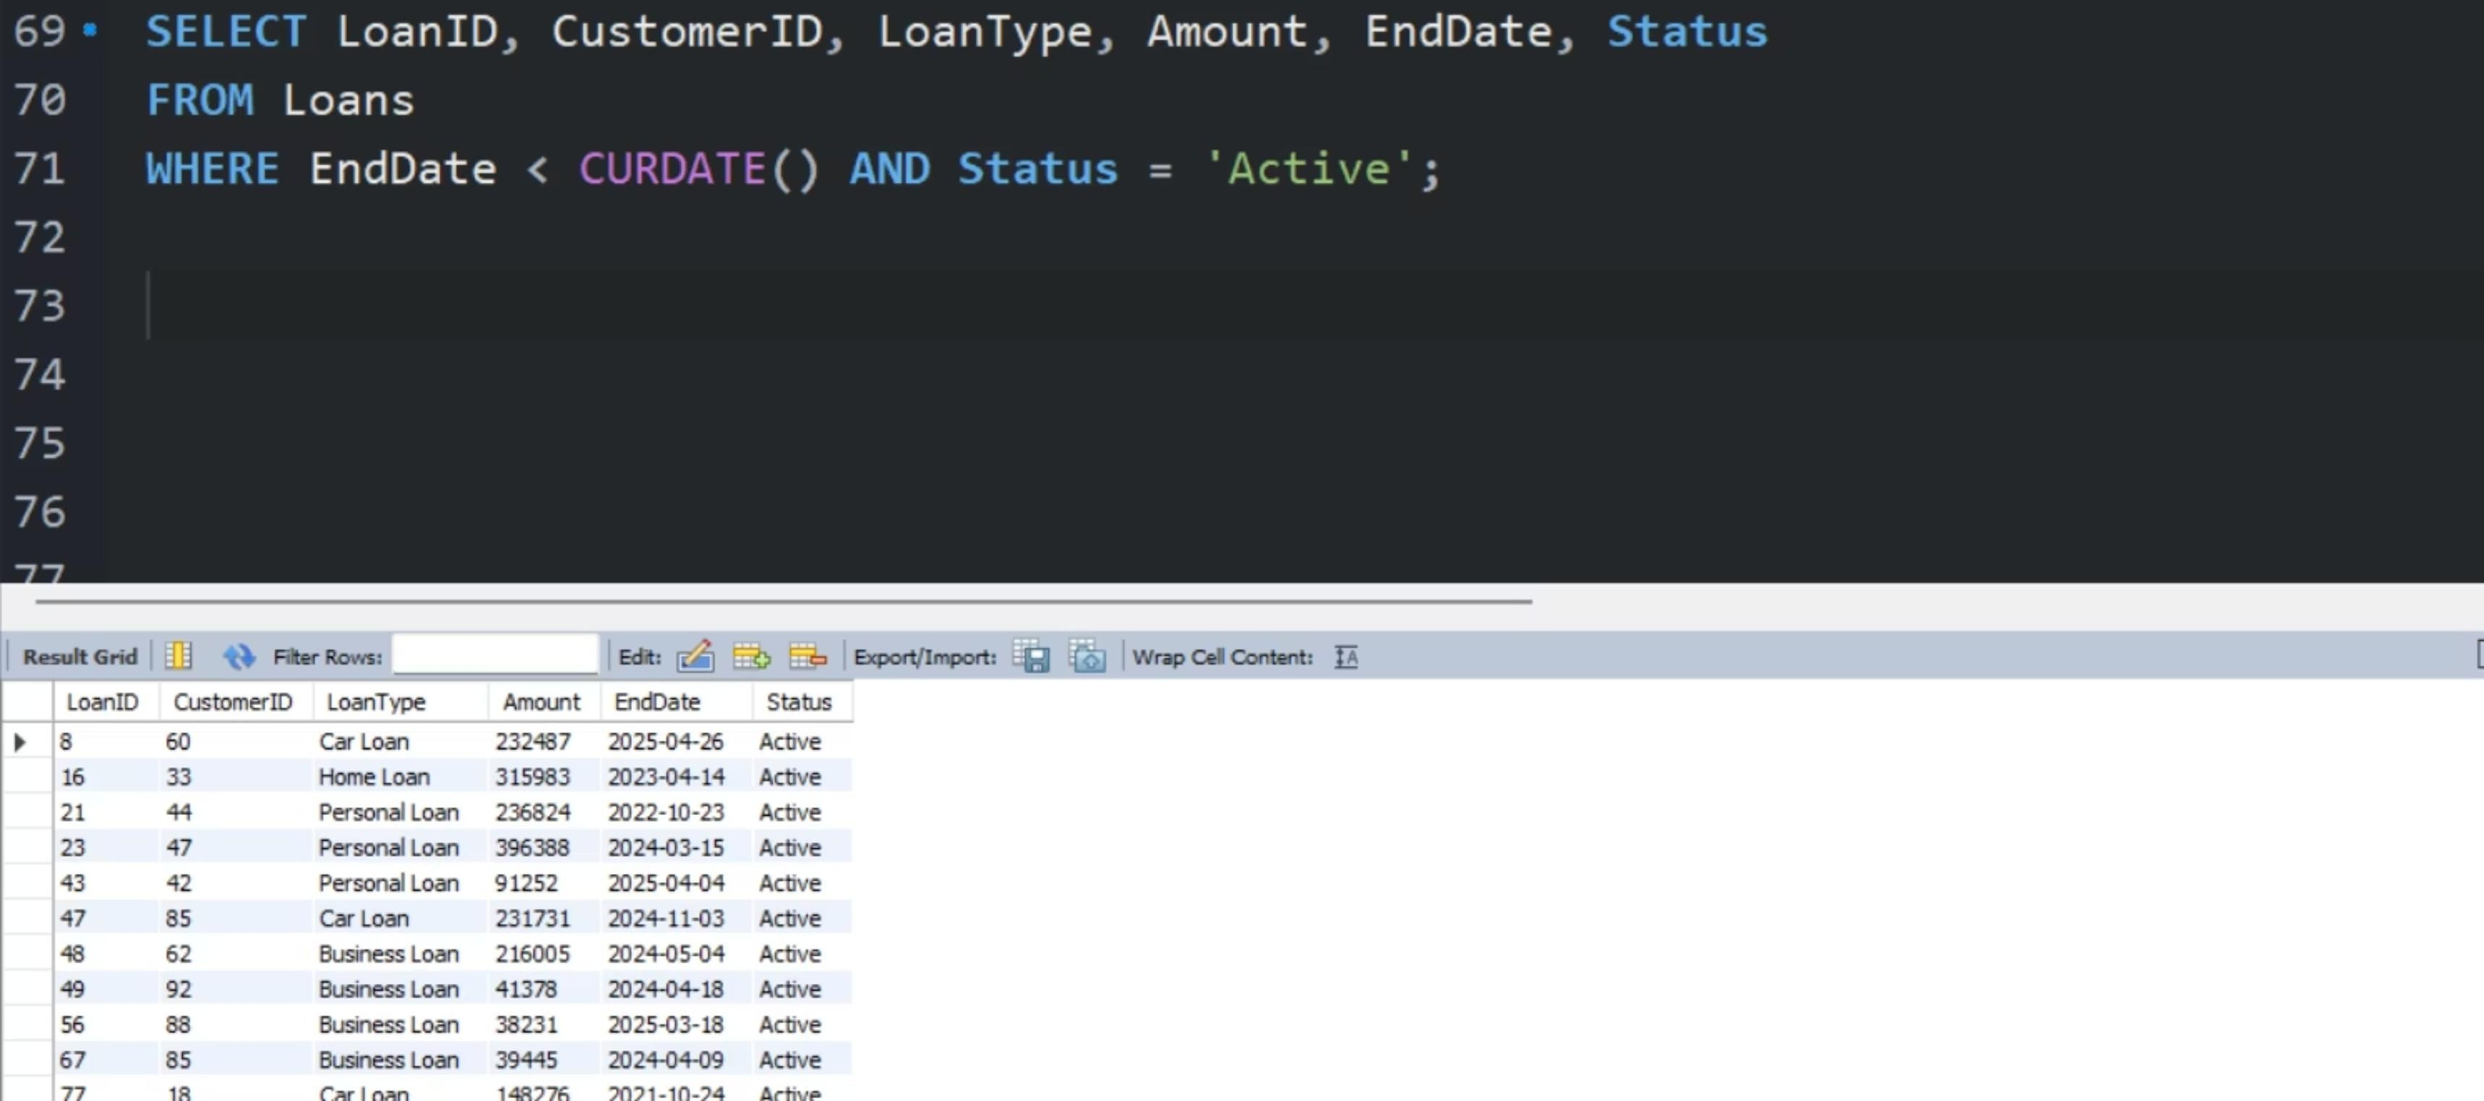
Insight 6 ) List loans where the end date has passed but the loan is still active, indicating overdue repayments.

Slide 22
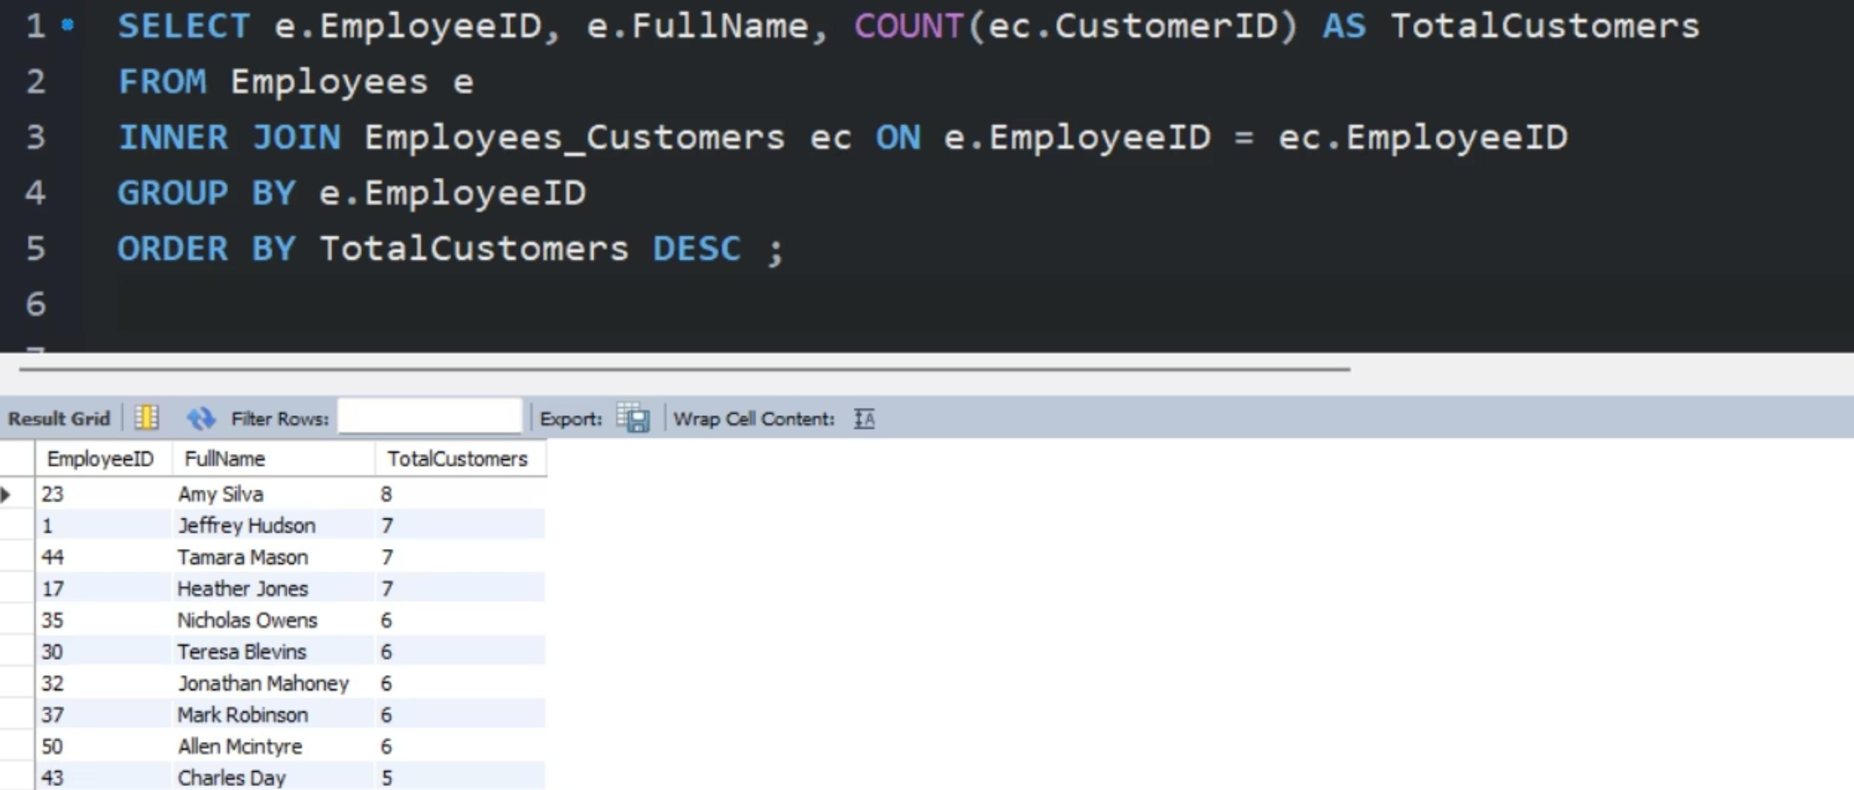
Insight 7 ) Retrieve the Employee who serves the largest number of customers.

Slide 23
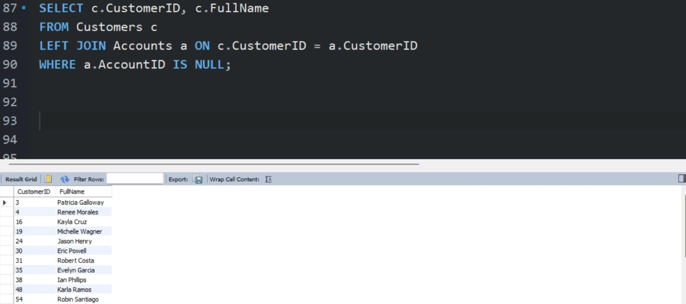
Insight 8 ) Find customers who do not have any linked bank accounts, which is important for follow-up.

Slide 24
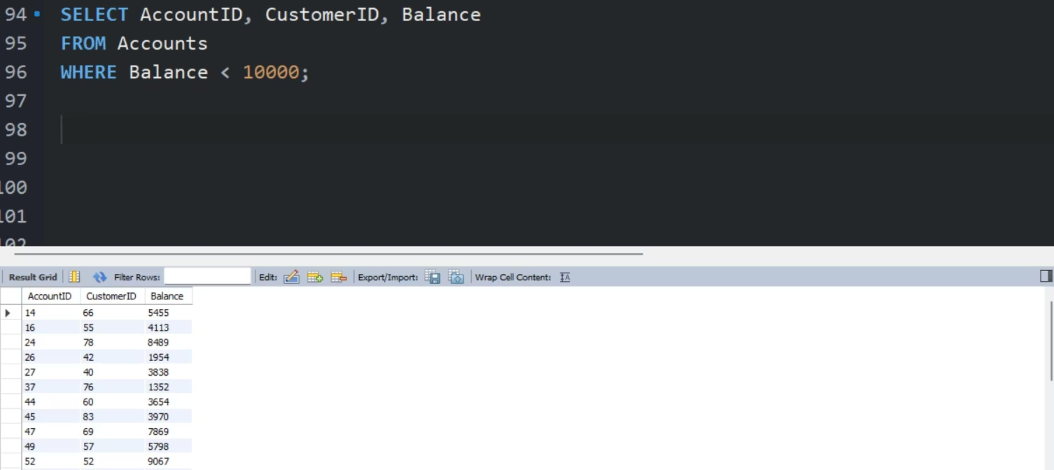
Insight 9 ) Detect accounts with a balance less than 10000 currency units, useful for monitoring low-balance or near-closed accounts.

Slide 25
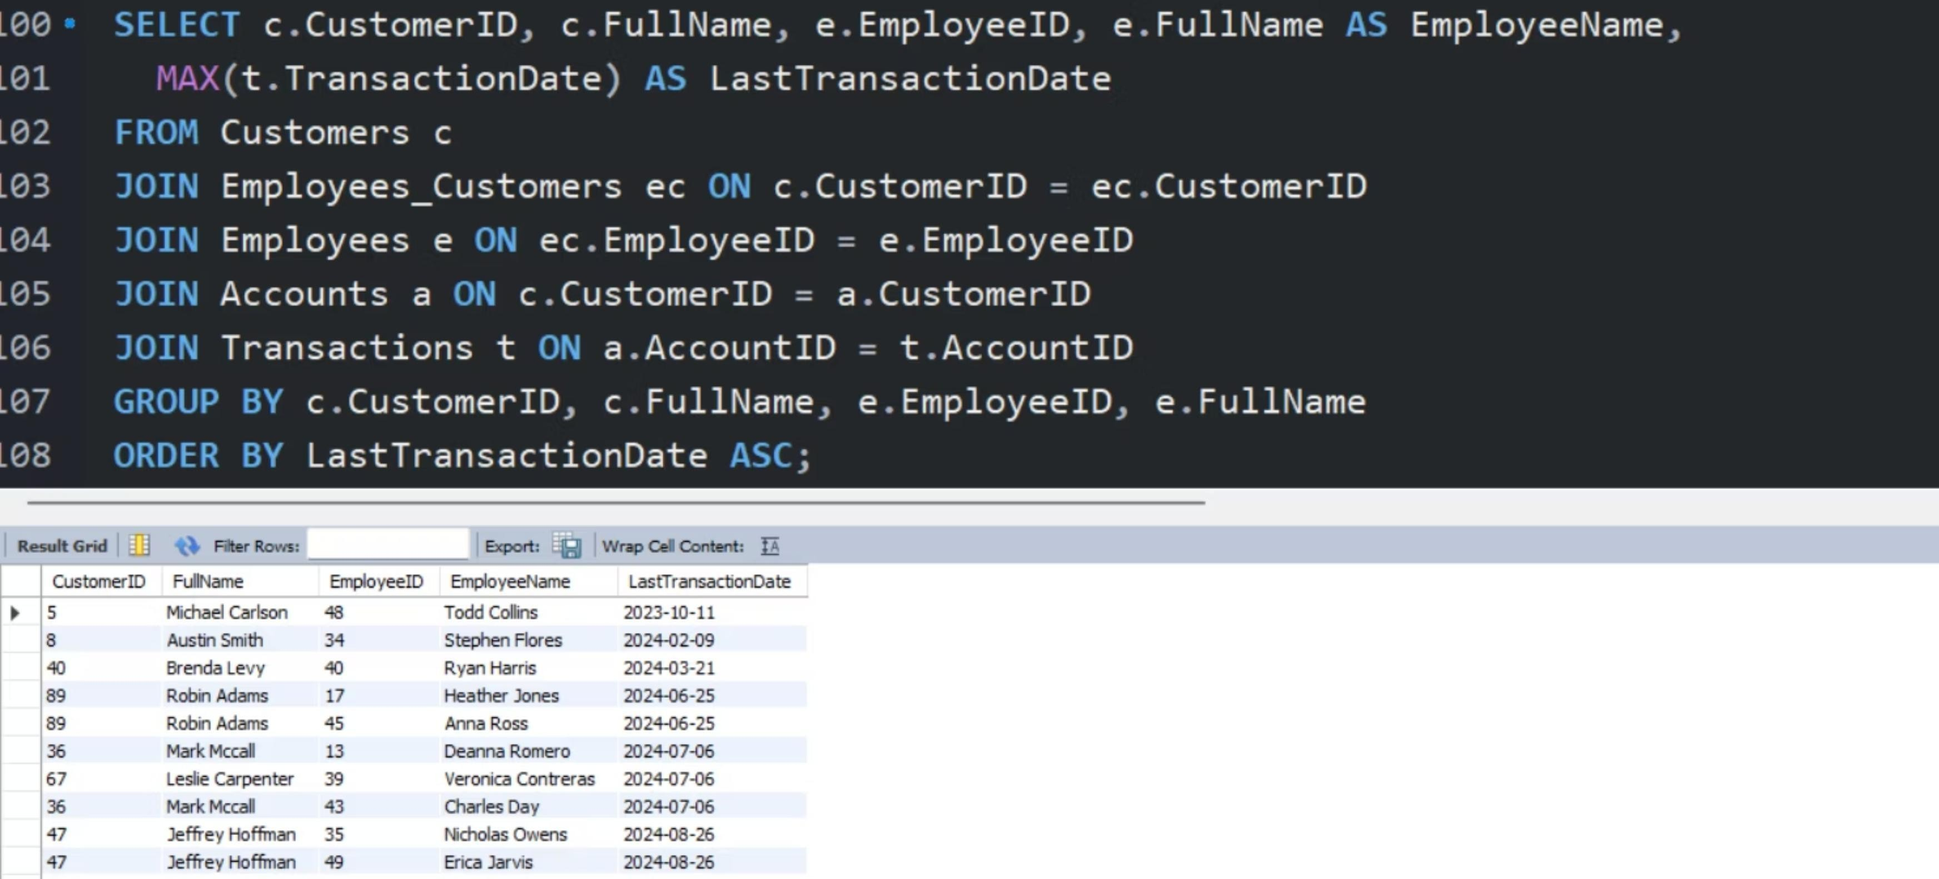
Insight 10 ) Show each customer, their assigned employee, and the date of their last transaction, sorted by oldest transaction first to prioritize follow-up.

Slide 26
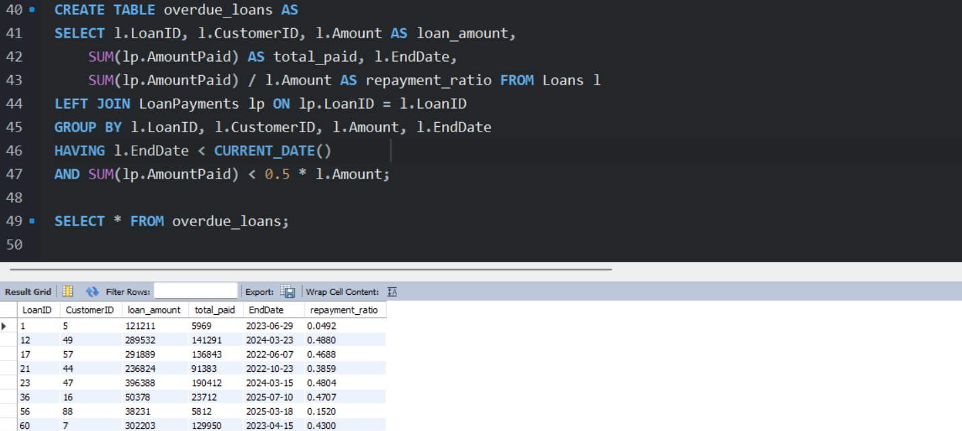
overdue_loans (CTAS) – Creates a table listing loans that have ended but have less than 50% of their total amount repaid, helping identify high-risk or overdue accounts.

Slide 27
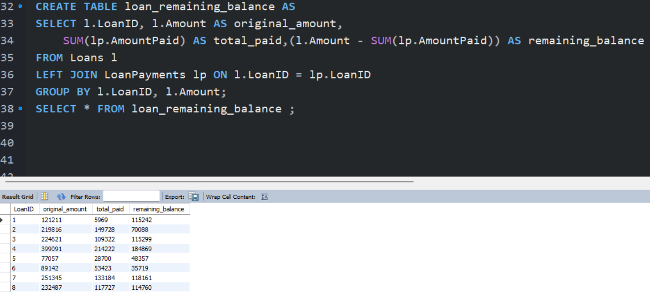
loan_remaining_balance (CTAS) – Creates a table showing each loan’s original amount, total amount paid, and remaining balance to track outstanding debts.

Slide 28
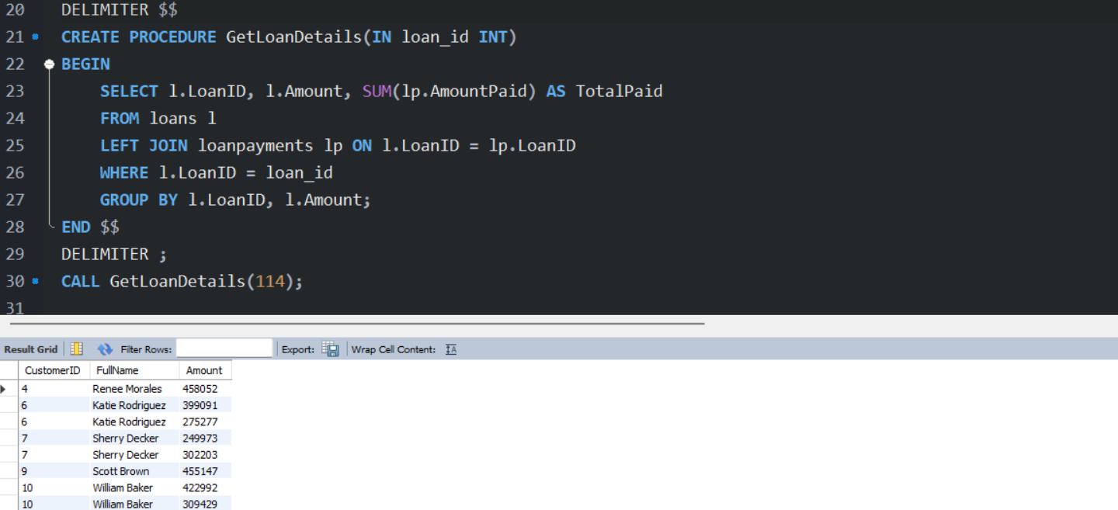
GetLoanDetails (Procedure) – Retrieves a specific loan’s amount and total payments made, allowing quick access to repayment details by loan ID.

Slide 29
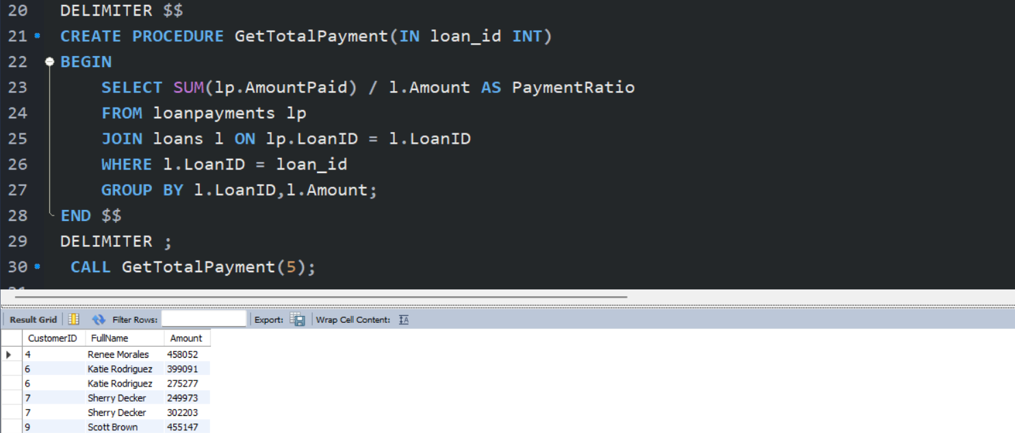
GetTotalPayment (Procedure) – Calculates the payment ratio for a given loan by comparing the total amount paid to the loan’s original amount, helping measure repayment progress.

Slide 30
Objective
To design and implement a comprehensive Bank Management System using SQL that efficiently manages customeraccounts, transactions, loans, and employee records, while ensuring data integrity, security, and scalability.The system aims to provide accurate reporting, streamline banking operations, and support informed decision-making through data modeling, data cleaning, and business analysis. Additionally, the project serves as apractical application of database concepts, enhancing skills in SQL queries, stored procedures, and relationaldatabase design.

Slide 31
Conclusion
Through developing the Bank Management System, we gained hands-on experience in a variety of important concepts, including data modeling, data cleaning, SQL query optimization, business analysis, and relational database design and management to ensure data accuracy.We also utilized Python for data processing, automation, and integration with SQL to enhance the system’s functionality.This project not only strengthened our technical skills in SQL and Python but also improved our problem-solving abilities and real-world banking understanding, enhancing our overall operational expertise.

Slide 32
Thank You
Ahmed Osama
PROFESSOR
𝗠𝗮𝗵𝗺𝗼𝘂𝗱 Talaat
Rahma Saber
Ibrahim Reda
Khaled Abdulrahman
Malak Sherif

